Slide 3
The Smart Way for your Lab

Slide 4
Introducing…..

Slide 5
ARIOSO

Slide 6
The New Water Production System

Slide 7
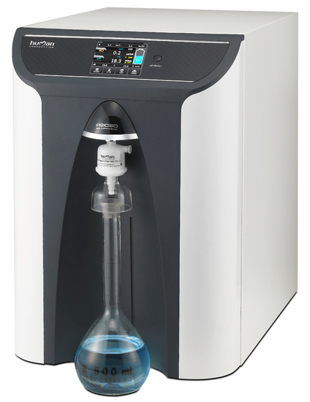
The New Water Production System
from

Slide 8
Compact
All in one
Up to three kind of
High purity water quality in one single instrument
Low running cost
Easy to use
Low maintenance cost

Slide 9
Four models
Able to produce
The best water quality
For all instruments
For all lab application

Slide 10
Four models available
Arioso Power
The unique W.P.S.
able to produce
ASTM class Type I – II – III
In one single unit
from tap water

Slide 11
Four models available
Arioso Power
The only W.P.S.
Based on
“no tank through “ technology

Slide 12
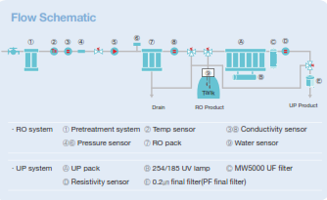
Four models available
Arioso Power
The “no tank through “ technology
A simple idea to save money

Slide 13
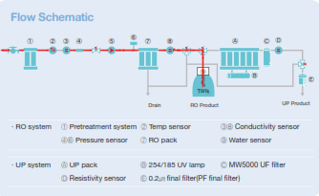
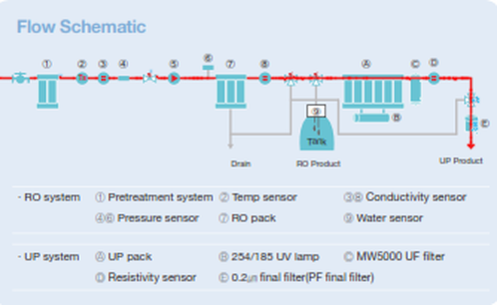
Four models available
Arioso Power
The “no tank through “ technology
guarantees Ultrapure Water type 1
saving money day by day….

Slide 14
Four models available
Arioso Power
…And reducing the running cost down to
0.25 $ per liter only (*)
(*) based on estimation of annual production of 5000 liters (75% ASTM type III & II – 25% ASTM type I)

Slide 15
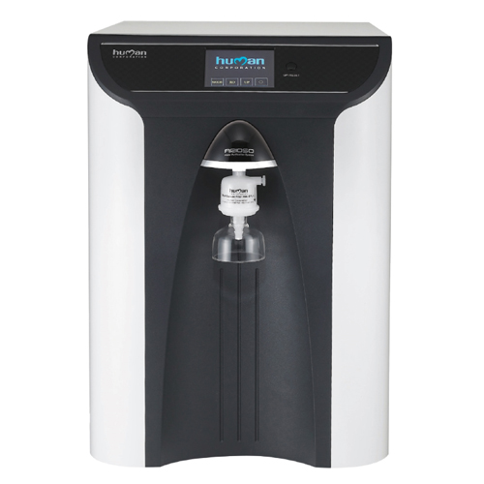
Four models available
Arioso EDI
Based on ElectroDeIonization
at the lowest running cost
on the market from tap water
ASTM class Type II

Slide 16
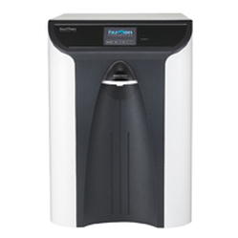
Four models available
Arioso RO HP
ASTM class Type III & II
from tap water
perfect for medium small labs with high daily volume need

Slide 17
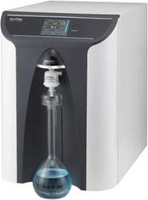
Four models available
Arioso UP
ASTM class Type I
from RO, deionized or distilled pre-treated
water with a production
Up to 2 lt/min

Slide 18
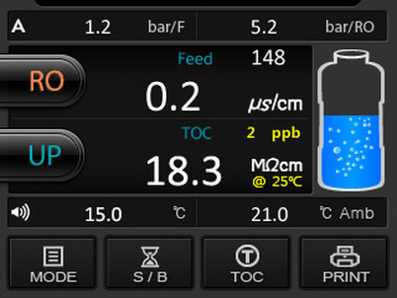
Unique Human interface
All parameters in one screen shot
Touch screen display
One touch start
Programmable timer
for RO and UP

Slide 19
Unique Easy Maintenance
All consumables
accessible from the
front door
Quick connectors

Slide 20
Unique Support

Slide 21
The Smart way for your Lab

